Slide 1
Residual Connections in Deep Neural Networks Understanding Gradient Challenges in Neural Networks: The Efficacy of Residual Blocks (ResNet)
Subject: 32513 Advanced Data Analytics Algorithms, Machine Learning
Presented by: Gribesh Dhakal (24594374)

Slide 2
Project analysis slide 2
Journal Analysis
1. Visualising and Understanding Vanishing Gradient Problem
2. Visualizing and Understanding Exploding Gradient Problem
Journal
3. Implementing Model without Residual Connection
4. Implementing Model with Residual Connection (ResNet)
5. Comparison of Model
6. Conclusion

Slide 3
Project analysis slide 3
Problem Analysis
Gradient in Neural Networks
Calculation
Vanishing Gradient
Exploding Gradient
Impact on Training
Represents the change in loss with respect to a change in model weights.
Derived using the chain rule in calculus during the backpropagation process.
Gradients become very small; earlier layers learn slowly, leading to prolonged training.
Gradients grow very large; can cause unstable training and large weight updates.
Affected convergence, potential underfitting (for vanishing) or erratic behaviour (for exploding).

Slide 4
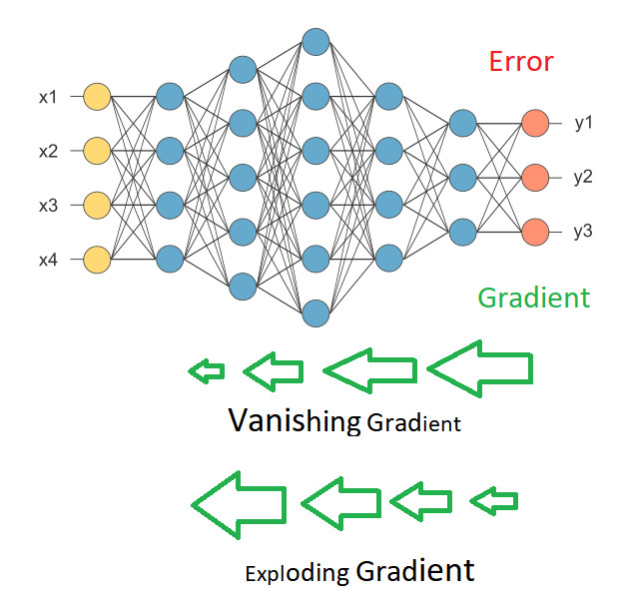
Project analysis slide 4
Gradient Problem

Slide 5
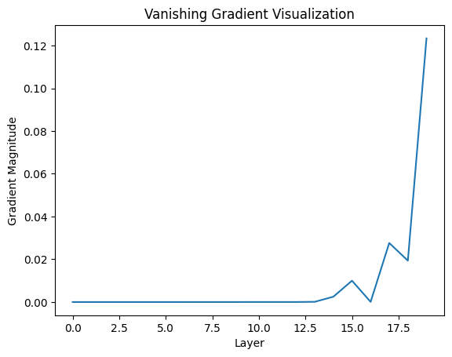
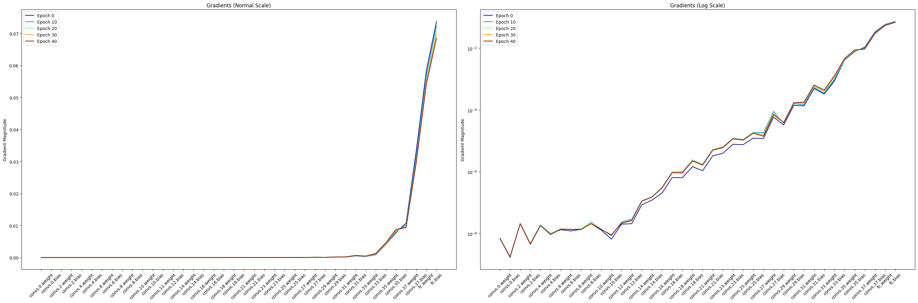
Project analysis slide 5
Vanishing Gradient Analysis
Variation of Gradient Magnitude
Simple CNN (Normal Scale)
Normal Scale
Log Scale
<0.12
<0.07
10⁻² to 10⁻⁸
As we move from last layer to first, gradient diminishes.

Slide 6
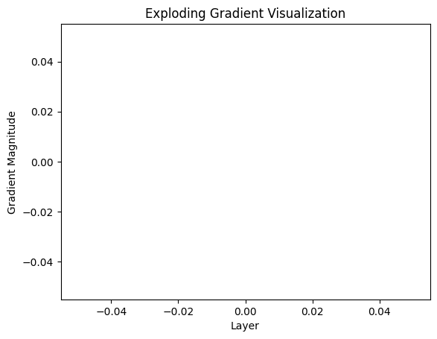
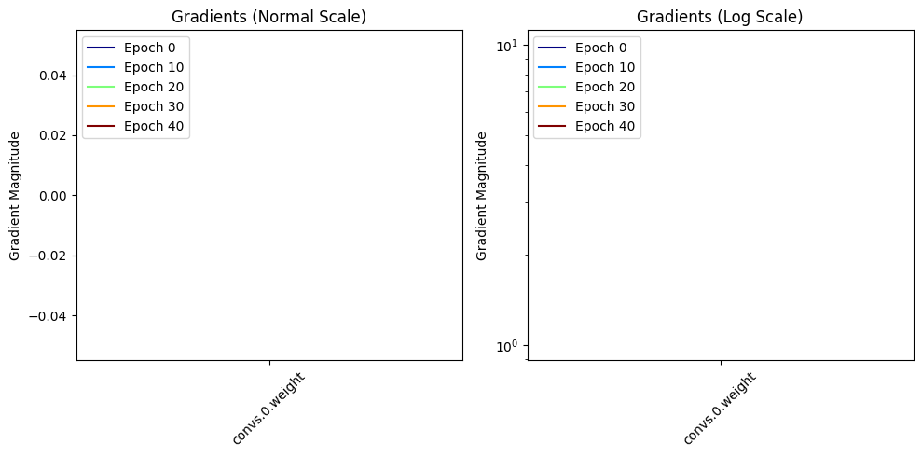
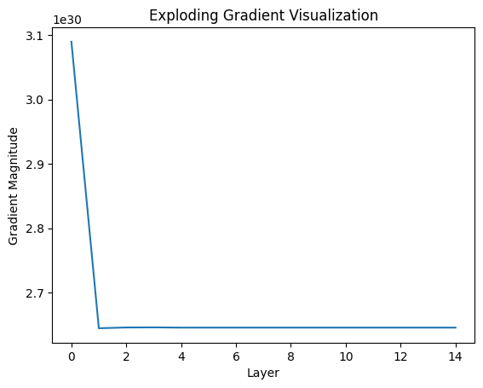
Project analysis slide 5
Exploding Gradient Analysis
Simple CNN
Simple CNN
Complex CNN
NaN or ∞
~1e30
NaN or ∞
Gradient Increase Sharply as we move from last layer to first layer.

Slide 7
Project analysis slide 6
Residual Connection
1. Concept:
Allows activation from one layer to bypass one or more layers and directly connect to a later layer.
2. Shortcuts
Uses "skip connections" or "shortcuts" to jump over certain layers.
3. Addressing Vanishing Gradient:
Improves backpropagation by providing an alternate path, mitigating the vanishing gradient problem.
4. Training Deep Networks:
Enables training of much deeper networks by ensuring adequate gradient flow.
5. Preserving Identity:
Allows the model to learn identity functions which help in stacking layers without hindrance.
6. Enhanced Feature Propagation:
Promotes the reuse of features, thus making the network more efficient.

Slide 8
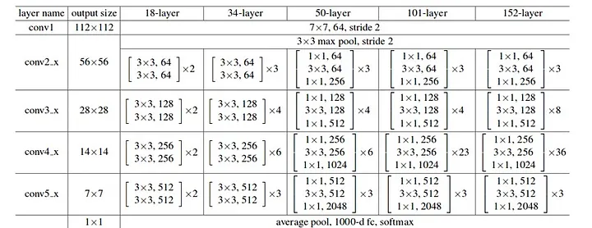
Project analysis slide 4
Different ResNet Models

Slide 9
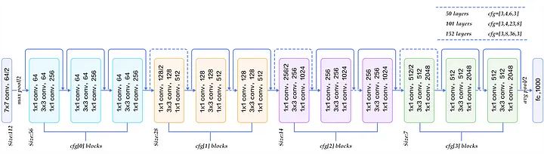
Project analysis slide 7
ResNet50 Architecture

Slide 10
Project analysis slide 8
Comparison
of Model with and without Residual Block
Without Residual Blocks
With Residual Blocks
Faster convergence and training due to skip connections assisting gradient flow.
Consistently high accuracy, benefiting from increased depth especially on datasets I have used.
Mitigates the vanishing gradient problem; more stable gradient flow.
Often slower due to gradient issues.
Plateaus or even degrades with increased depth.
Susceptible to both vanishing and exploding gradients.
Longer, requiring more epochs for comparable performance.
Performance degradation with increasing depth.
Loss fluctuations and potential stagnation during training.
Quicker training times due to efficient gradient flow and faster convergence.
Can handle increased depth without performance deterioration; exploits depth for complex datasets.
More stable training with fewer instances of loss fluctuations; consistent gradient flow aids in stability.

Slide 11
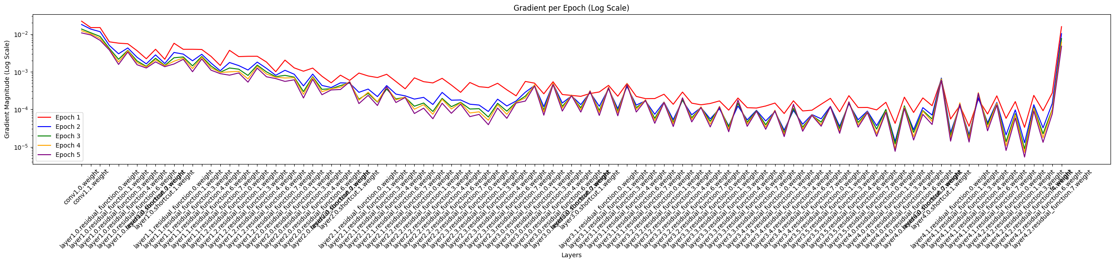
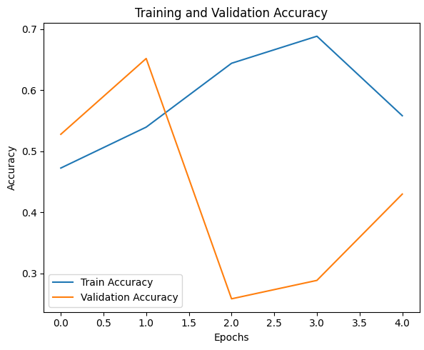
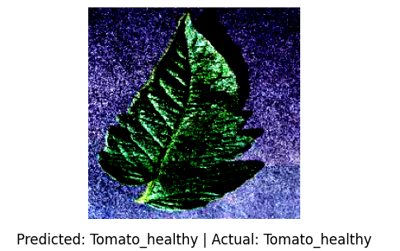
Project analysis slide 10
Conclusion
Significance of Gradients
Gradients are pivotal in training deep neural networks. Their magnitude directly impacts the speed and stability of the learning process.
Challenges with Deep Networks
As networks become deeper, they are prone to issues like vanishing and exploding gradients. These issues can severely impede model performance and training efficiency.
Residual Connections' Efficacy
Implementing residual connections, as seen in ResNet architectures, effectively addresses the gradient problems, enabling the successful training of ultra-deep networks and ensuring feature preservation across layers.

Slide 12
Thank You

